Slide 1


A PROJECT REPORT
ON
“TEXT FILE ENCRYPTION AND DECRYPTION”
SUBMITTED TO:
SHREE. KAKASAHEB HEERALAL MAGANLAL CHAUDHARI ARTS,
COMMERCE AND SCIENCE COLLEGE, NANDURBAR - 425412
(ACCREDITED WITH GRADE-B BY NAAC)
SUBMITTED BY:
MISS. CHAUDHARI JANHAVI NANDLAL
PRN: 2022015400038272
GUIDED BY:
PROF. PRIYANKA AGALE
IN PARTIAL FULFILLMENT OF DEGREE OF
BACHELOR OF COMPUTER APPLICATIONS (BCA)
KAVAYATRI BAHINABAI CHAUDHARI NORTH MAHARASHTRA
UNIVERSITY, JALGAON.
For the Academic Year 2024-2025

Slide 2
Encryption System Project
Java-based Encryption & Decryption Tool
By Janhavi Chaudhari

Slide 3
INDEX
Sr.No. | Content
1 | Introduction
2 | Objective
3 | Features
4 | System Requirements
5 | How It Works
6 | ER Diagram
7 | Data Flow Diagram
8 | Advantages
9 | Limitations
10 | Future Scope
11 | Conclusion

Slide 4
Introduction
What is Text File Encryption and Decryption?
Encryption is the process of converting plain text into unreadable ciphertext to protect it from unauthorized access.
Decryption reverses this process, restoring the original plain text from the ciphertext using a specific key.

Slide 5
Objective
Prevent unauthorized access to sensitive textual information.
Provide a user-friendly interface for encrypting and decrypting text files.
Utilize robust cryptographic algorithms to enhance data security.
Ensure that only authorized users with the correct decryption key can retrieve the original data.
Demonstrate the practical importance of data security in modern digital communication.

Slide 6
Features
1. Encryption Algorithm Options
2. Password Protection
3. User-Friendly Interface
4. Multi-Language Support
5. Key Management

Slide 7
System Requirements
Hardware:
Minimum: Intel i3, 4GB RAM, 250GB HDD
Recommended: Intel i5+, 8GB RAM, SSD
Software:
OS: Windows/Linux/Mac
Languages: Python/Java
IDE: VS Code / Eclipse/ Apache Netbeans
Libraries: cryptography, tkinter for GUI (if needed)

Slide 8
How It Works
1. User selects a `.txt` or `.java` file
2. Enters a password for encryption
3. File is converted into cipher text using custom algorithm
4. Cipher text can be saved and transmitted
5. Receiver uses same password to decrypt and retrieve original file

Slide 9
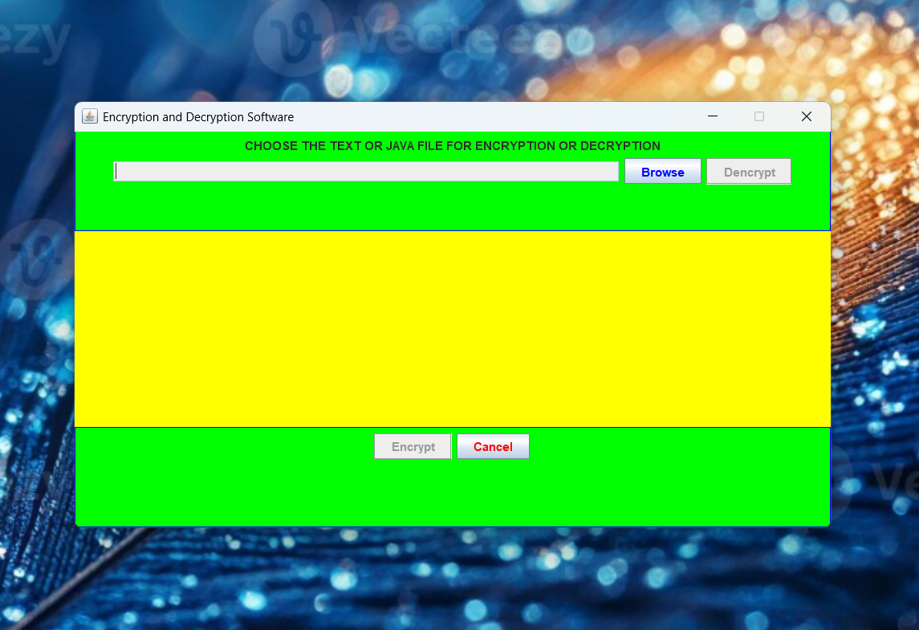

Slide 10
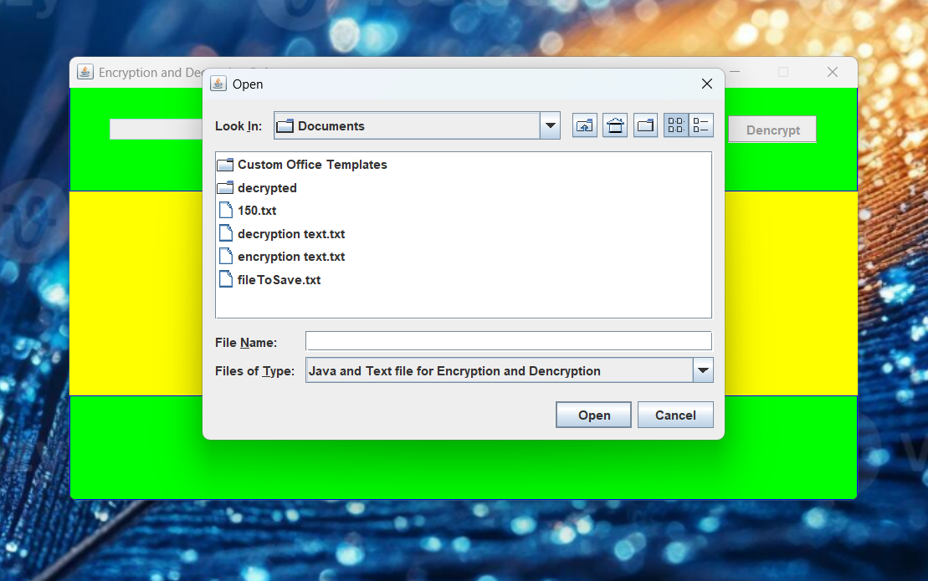

Slide 11
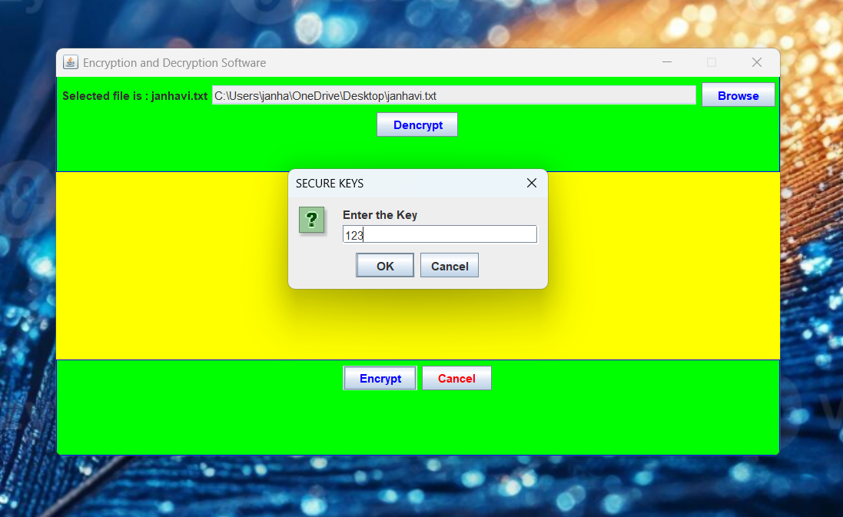

Slide 12
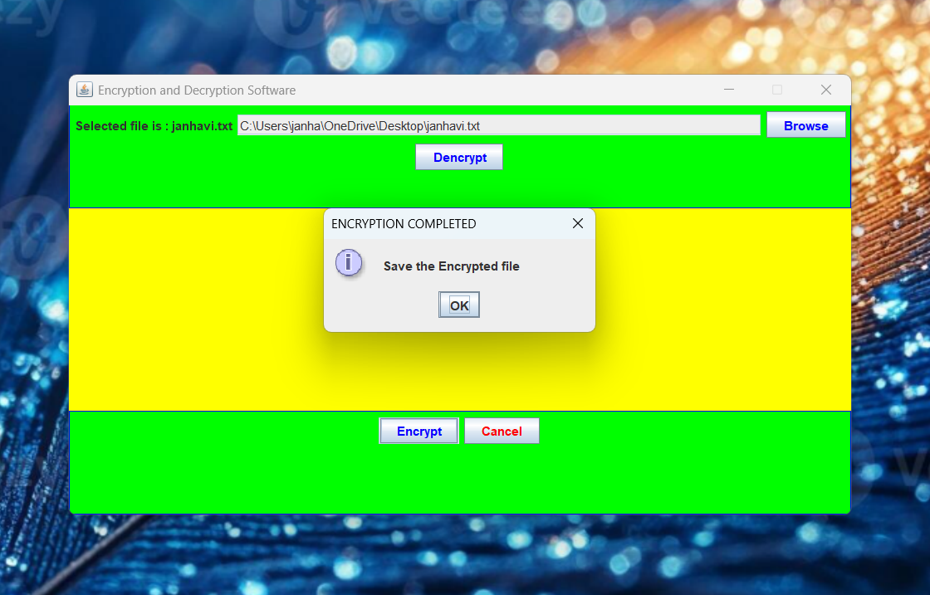

Slide 13
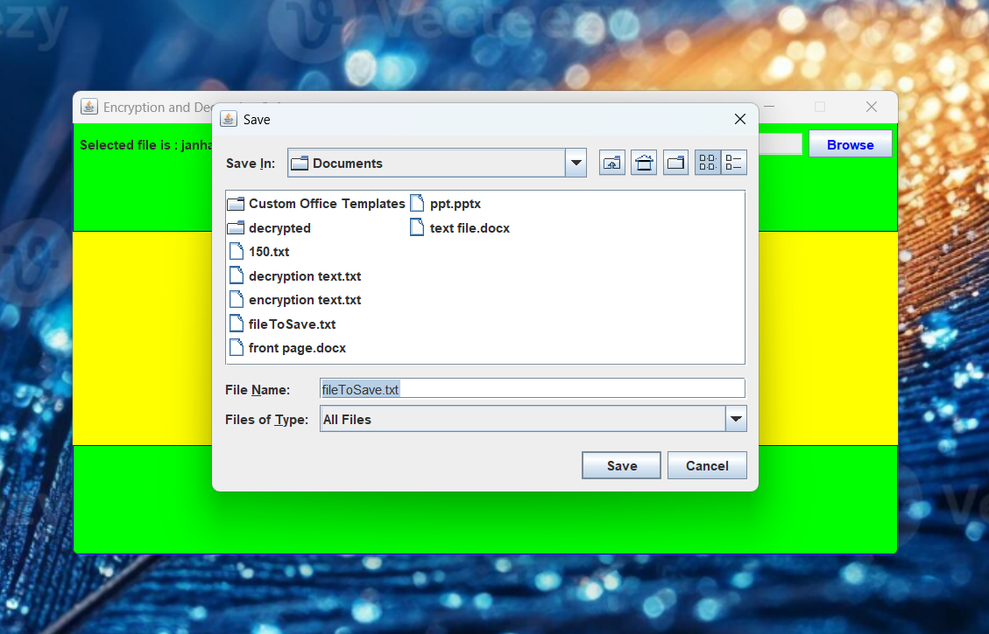

Slide 14
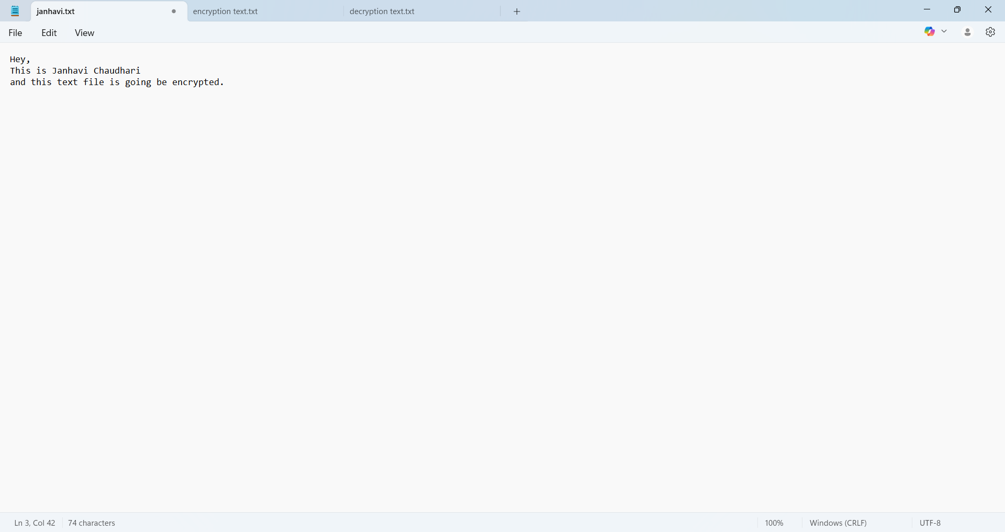

Slide 15
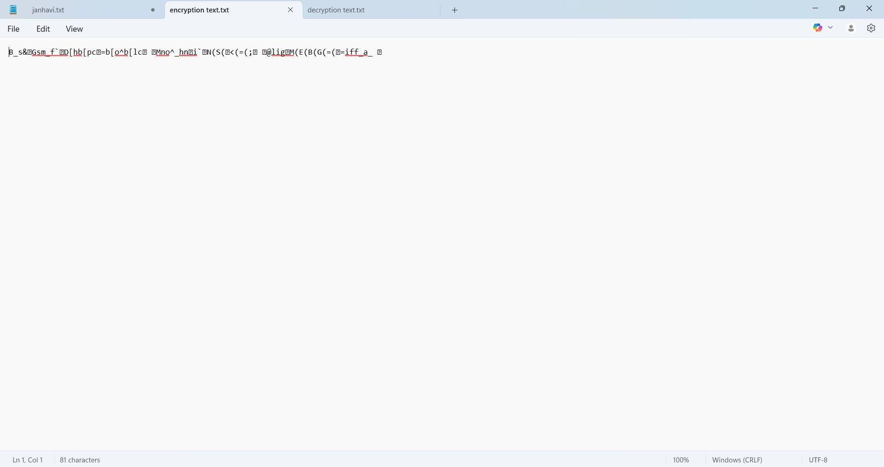

Slide 16
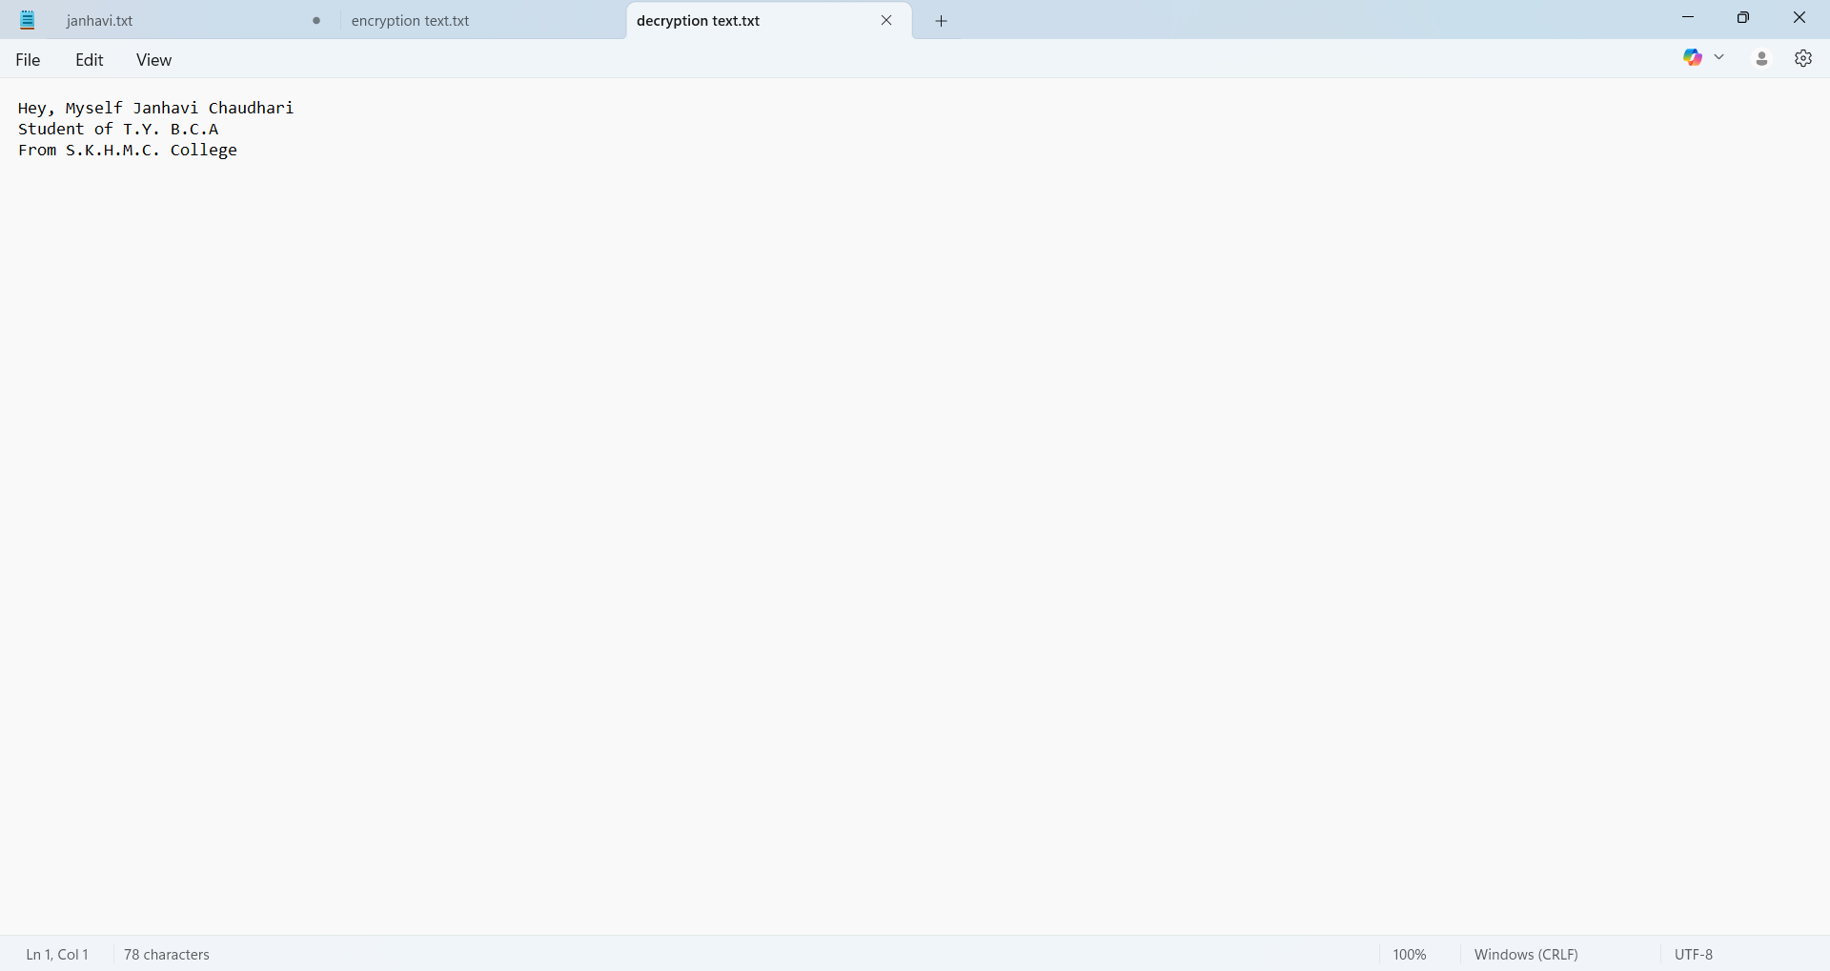

Slide 17
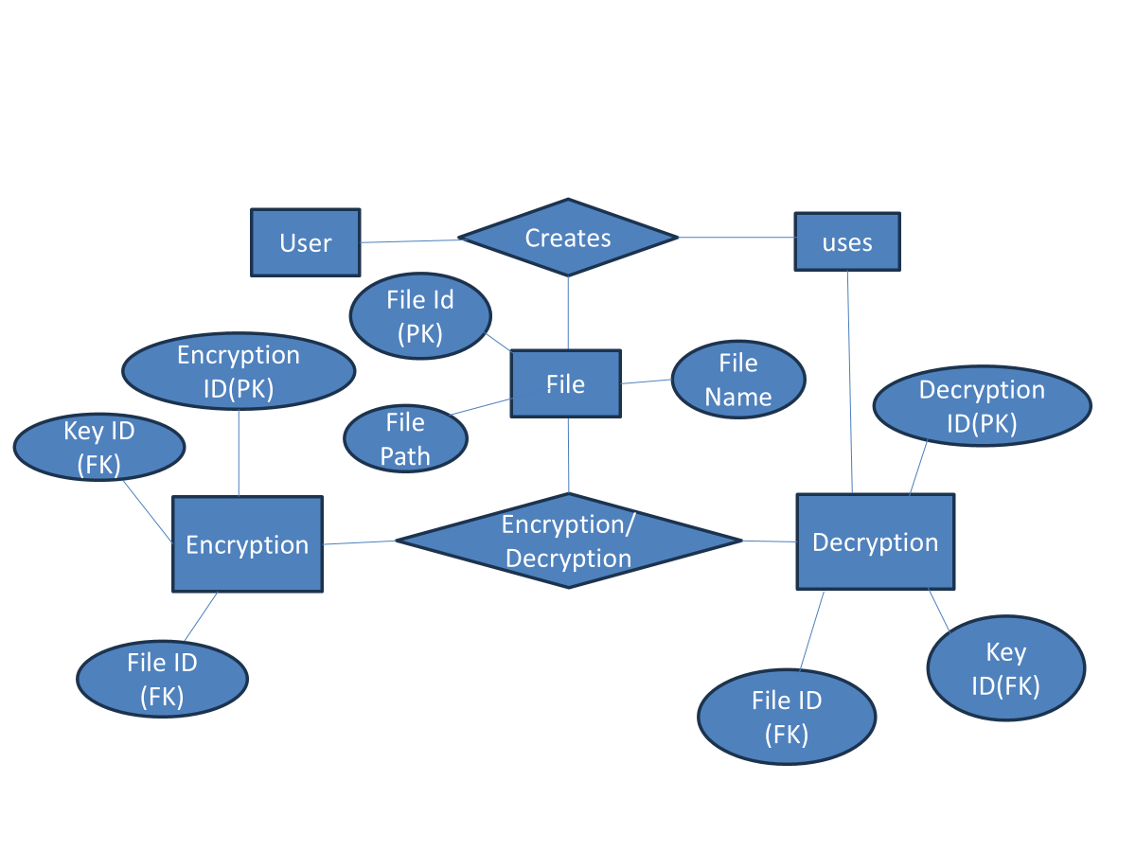
ER Diagram

Slide 18
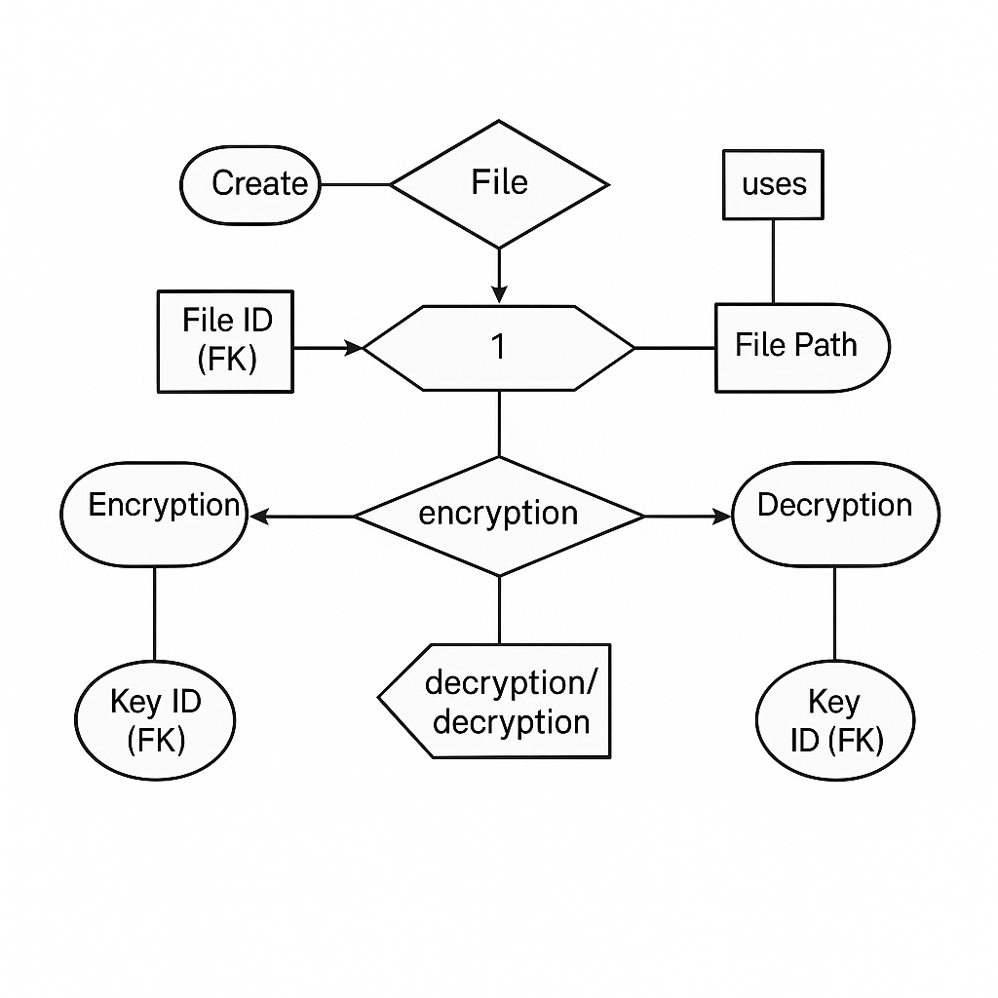
Data Flow Diagram

Slide 19
Advantages
Enhances file security for sensitive information.
Prevents unauthorized access during file transmission.
Password-based system ensures only intended users can decrypt files.
Easy integration with Java-based applications.
Simple GUI improves user experience.

Slide 20
Limitations
Supports only .txt and .java files.
Relies on the strength of the user's password.
Custom algorithm may lack peer-reviewed cryptographic strength.
No recovery option for forgotten passwords.
Does not support large file encryption efficiently.

Slide 21
Future Scope
Expand support to additional file formats like .pdf and .docx.
Implement stronger and standardized encryption algorithms (e.g., AES, RSA).
Add password recovery mechanisms with security questions or email verification.
Optimize performance for encrypting large files.
Develop mobile and web-based versions for cross-platform use.

Slide 22
Conclusion / Features
🔒 Strong file-based encryption
📂 Supports `.txt` and `.java` formats
🔑 Password-based cipher system
📡 Safe for public network file transfer
🚀 Easy-to-use graphical interface

Slide 23
Thank You…

